Slide 1

aspiring minds university
Introduction to Statistical Learning
Module 2b
Model Building : Linear Regression

Slide 2
Model Building : Linear Regression
Linear Regression
Assumes an additive, linear relationship between the predictors [X’s] and the response[Y]
is very simple
Is highly interpretable
Can be extended easily to account for non-linearity
Several of the more complicated methods GLMs, Lasso/Ridge regularization etc

Slide 3
Say you have n data points with p predictors and 1 response variable. Then, a simple linear model assumes that for any one data point,
Thus,

Slide 4
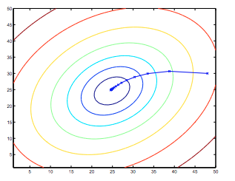
Least Squares Method
We must learn the parameters B_{0,} B_{1,} B₂ ….
To do this, we define the cost of any model as the RSS
How does it work under the hood?
The algorithm starts at some random setting for the parameters and then descends the gradient for RSS to come to the optimal value. This is a common method called gradient descent.
See an example of fitting using sci-kit learn here!
Image Credit: CS 229 Notes – Andrew Ng

Slide 5
Model Evaluation: Assessing a built model
R²
A measure of how much of the variability in the data is explained by the current model.
Lies between 0 and 1.
Higher is better
A measure of how similar response and predicted response are.
Lies between 0 and 1.
Higher is better
Use numpy to calculate
On Sci-Kit : See here!

Slide 6
Feature selection Which predictors to include while building a model?
Forward feature selection:
Starts with a null model with no predictors. Adds the best first feature, second best feature and so on ( based on p-values).
Backward feature selection:
Starts with a model with all predictors. Removes the least significant predictor, the next least and so on until removing a feature causes significant change to the model R^2. See this
By-hand:
Use all predictors, see which ones have higher t-stat values, use them in the regression

Slide 7
Categorical Data
If some predictor is categorical (discrete, fixed possibilities), then you cannot use it as-is in a regression! (why?)
Instead, we create dummy variables for each category. Say there are 3 categories for a predictor, then we replace the predictor with 3 different binary predictors that take value 0 or 1 depending on if the data point belongs to that category.
See: Sci-Kit Learn Categorical Variables and Wiki

Slide 8
Common Pitfalls
Non-linearity of f
If f, the relationship between the predictor and response is not actually linear then the error will have systematic bias.
Plot the residuals vs fitted values to get a good idea if this problem appears
Possible Common non-linear forms:
Polynomial (See poly features Scikit)
Exponential – log transform response ( Y -> log(Y))

Slide 9
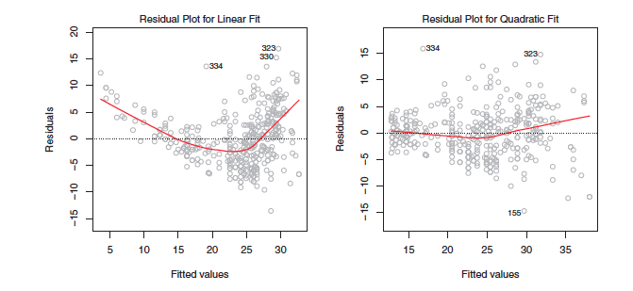
From the residual plot, it is apparent that the linear model has made a systematic error in predicting response. On fitting a quadratic model, it does much better and there is no definite trend in the residuals.
To find out how linear models can be extended to fit other types of relationships quite easily. Try and find out how.

Slide 10
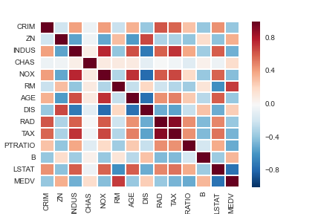
Common Pitfalls
2. Collinear predictors
If two or more predictors are highly correlated, then they increase and decreases together. This makes it difficult for the model to separate out the effect of each individual predictor and leads to unstable results. You need to remove highly correlated features.
Use a correlation plot of the features to find out
if such a situation has occurred.

Slide 11
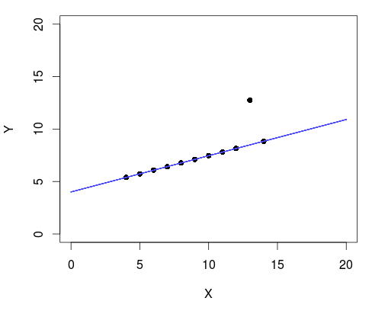
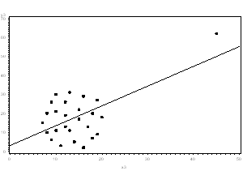
Common Pitfalls
3. Outliers and Influential Points
Points that have y values very different from those of points having similar predictor values are called outliers – they cause the model to appear less accurate than it is.
High leverage points are those that have X values very different from bulk of the data. They affect the model parameters.
Find these points by visualizing ( scatter, dimension reduced scatter etc) and remove them.
Outlier :
Influential Point:

Slide 12
Ex 2b: Boston Housing Data!
Download the files housing_data.txt and housing.names
Predictors = x’s = CRIM,ZN,INDUS,CHAS,NOX RM, AGE,DIS,RAD,TAX ,PTRATIO,B,LSTAT
Response = Y = MEDV
Download Ex2b- Housing, Linear Regression
Build your model!

